Slide 1

EV3lessons.com
A FLL World Class Project
to improve the way we learn EV3 Programming
Made for FLL Nigeria
Not the Droids You Are Looking For
FLL Team #51
Pittsburgh, PA

Slide 2
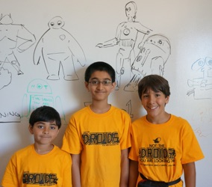
WHO Are We?
We are a 4th year FLL team from the United States
We are a team of 3 boys ages 10-12
EV3Lessons.com is our 2014 Research Project to improve the way we learn EV3 Programming
Team History:
2011: 3rd Place Champions Western PA
2012: 2nd Place Champions Western PA
2013: 1st Place Champions Western PA
2014: 1st Place Innovative Solutions FLL Intl Open Canada

Slide 3
What is ev3lessons.com?
Lessons are Open Source and written by kids on FLL teams
Used by 1000+ teams/groups worldwide
Teaches useful FLL Programming techniques in a new way
TESTIMONIALS
“Lessons are clear, concise and very relevant to FLL”
“The solutions are simple enough that rookie teams can understand them”
“Your lessons are the best, most useful, and most detailed that I have found!”
“Your lessons are presented in an easy to follow format that anyone can follow”
“You offer great notation about what is happening with each step of the EV3 program”

Slide 4
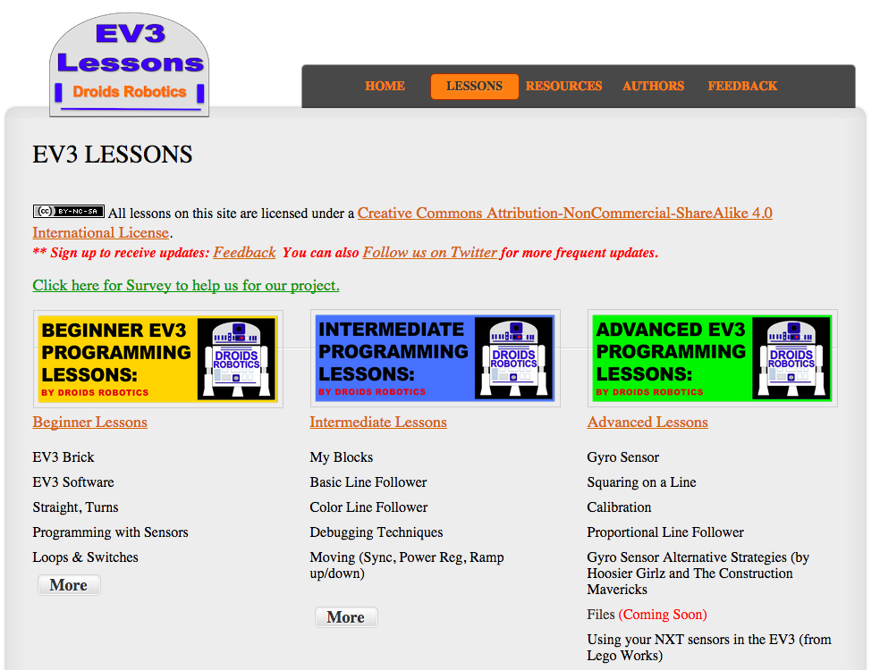
We have lessons on many topics USEFUL FOR FLL
Sample Topics:
Loops & Switches
My Blocks
Line Following
Color Line Following
Debugging
Move Blocks
Using the Gyro
Squaring
Calibration
Proportional Control

Slide 5
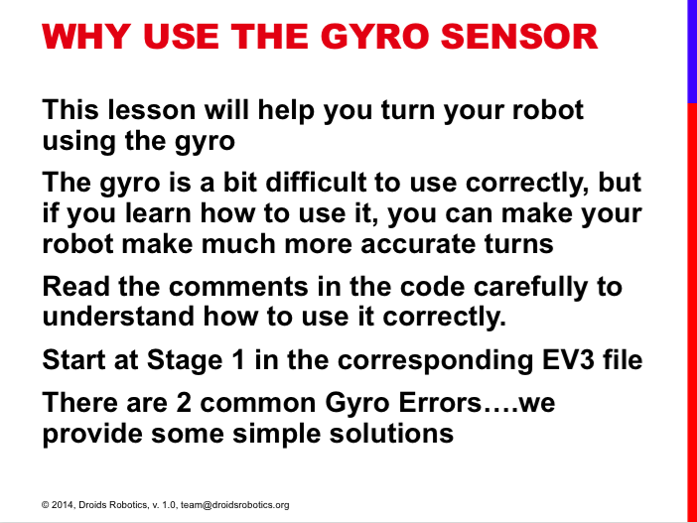
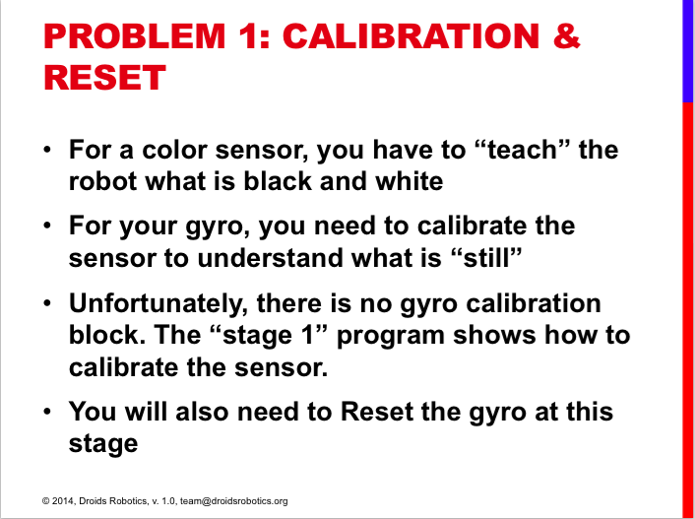
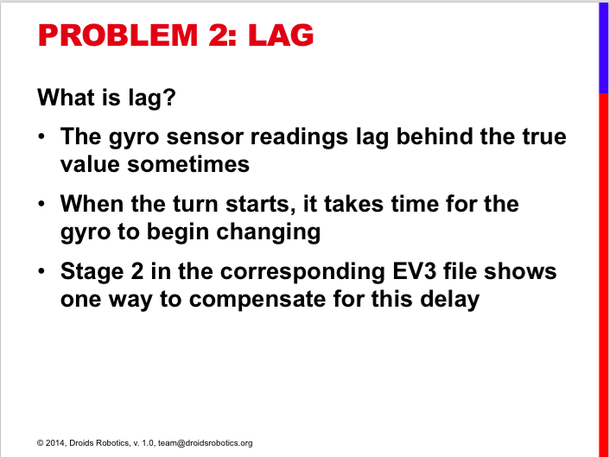
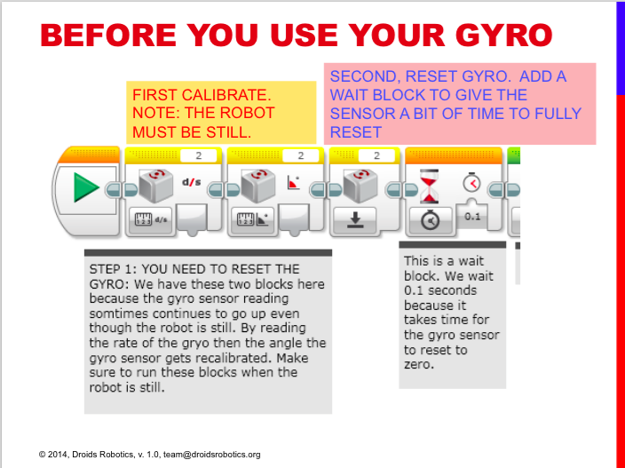
Lesson Snapshot: GYRO
Explanations provided for common problems

Slide 6
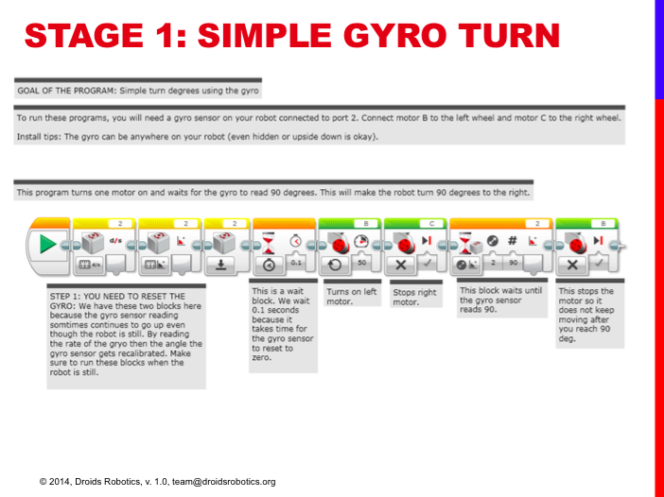
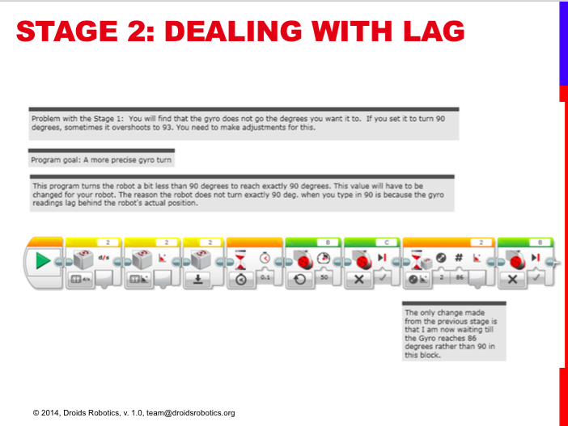
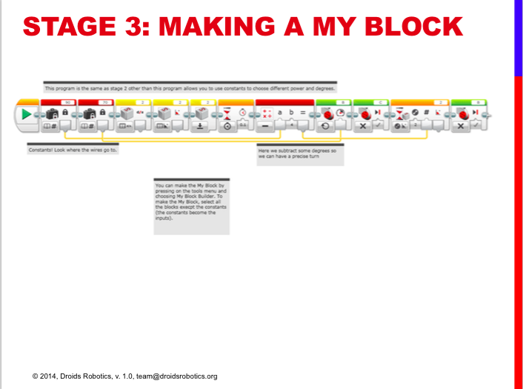
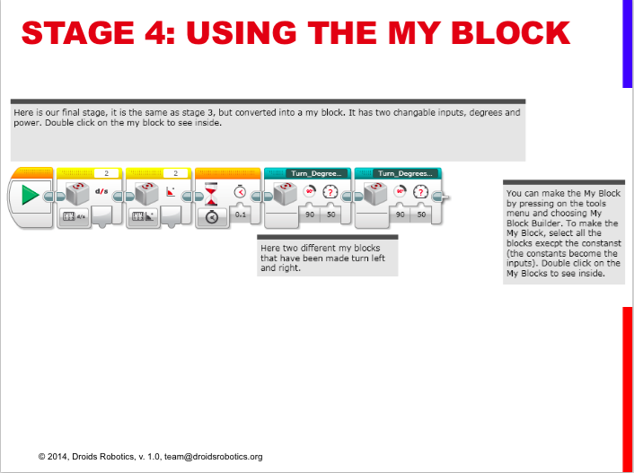
Lesson Snapshot: GYRO
Code and lesson are presented in easy to follow steps

Slide 7
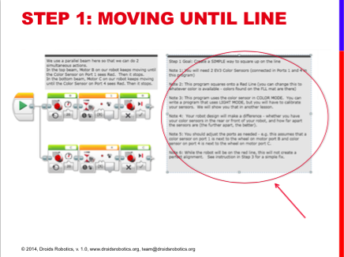
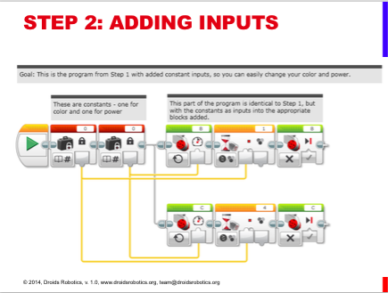
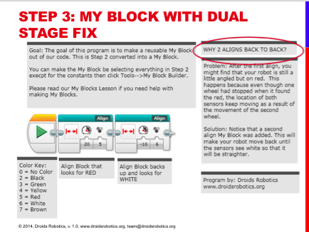
Lesson Snapshot: Squaring on a line
Downloadable EV3 Code with Detailed comments so you can test the code out, understand it and modify it as needed

Slide 8
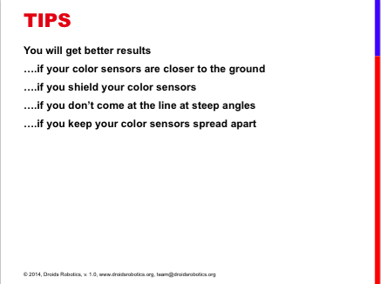
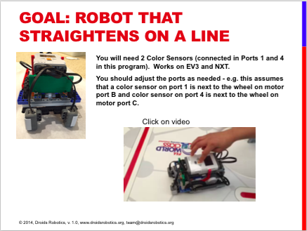
Lesson Snapshot: Squaring on a line
Tips for better results and
embedded videos to see what the robot should do

Slide 9
Where can I get the lessons and Code?
All lessons and code can be downloaded from
www.ev3lessons.com
Open source.
Written by FLL Kids

